Slide 1
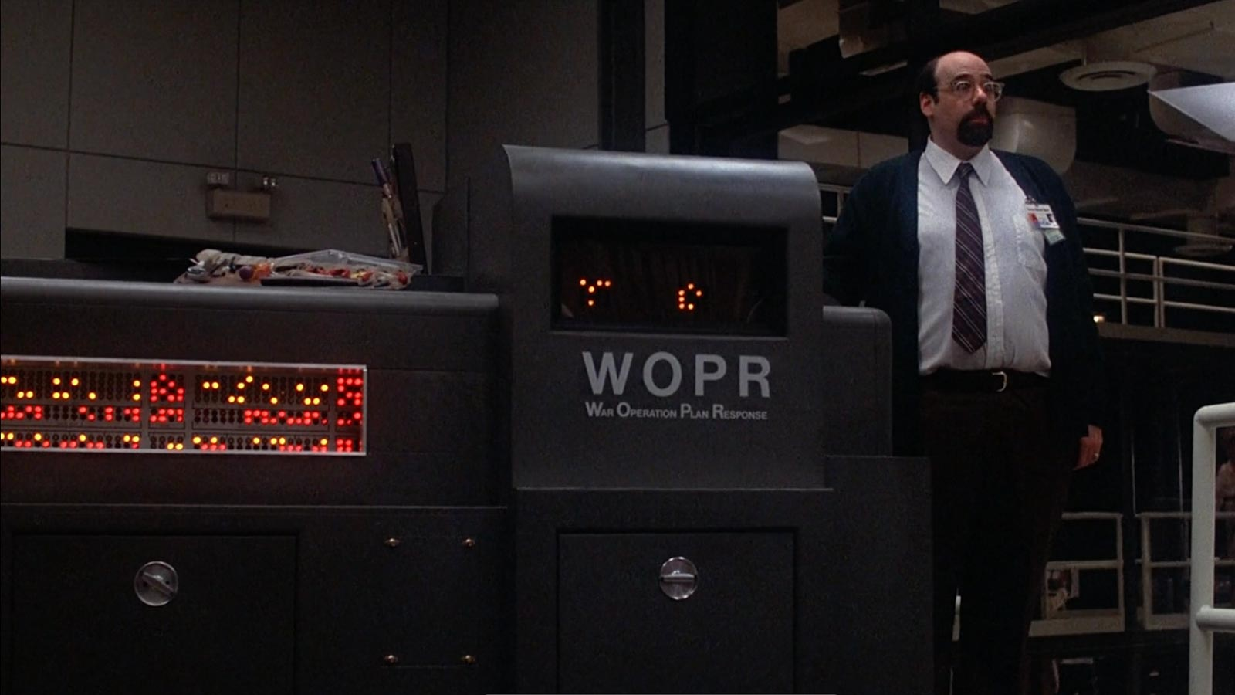
WOPR for the IBM 5150/60
Or only the LEDs, really.
*Apple ][ not included

Slide 2
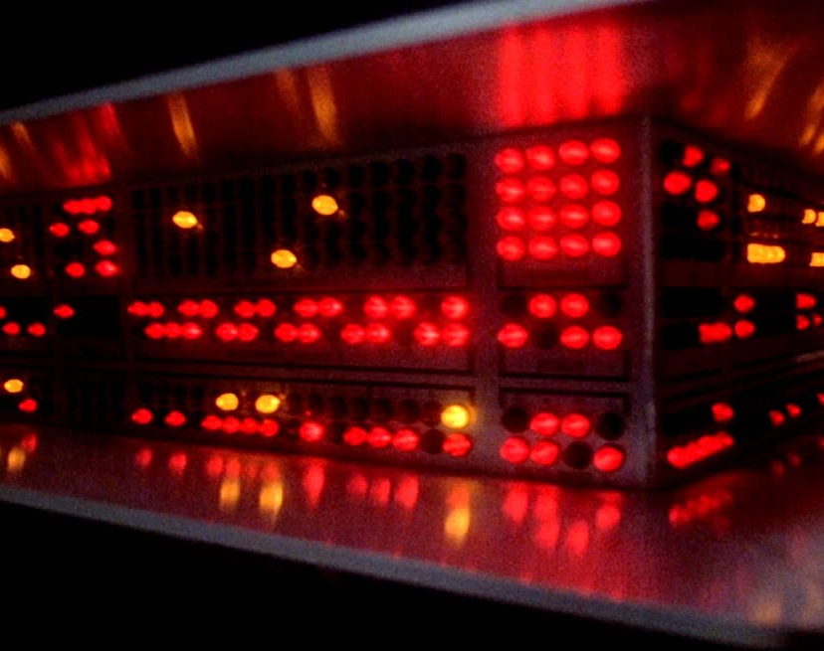
What is WOPR?
WOPR, or War Operation Plan Response, is a supercomputer in the 1983 movie War Games. Although not having that many registers, WOPR has loads of LEDs all around it to make it look “super”. The computer controlling the LEDs were an Apple //e.
There’s a possible Soviet equivalent designed by the late General Secretary Gorbachev called the ЪЇGMДҠ.
Failed attempt at regression Machine Learning
The IBM PC happens to be from the same era.

Slide 3
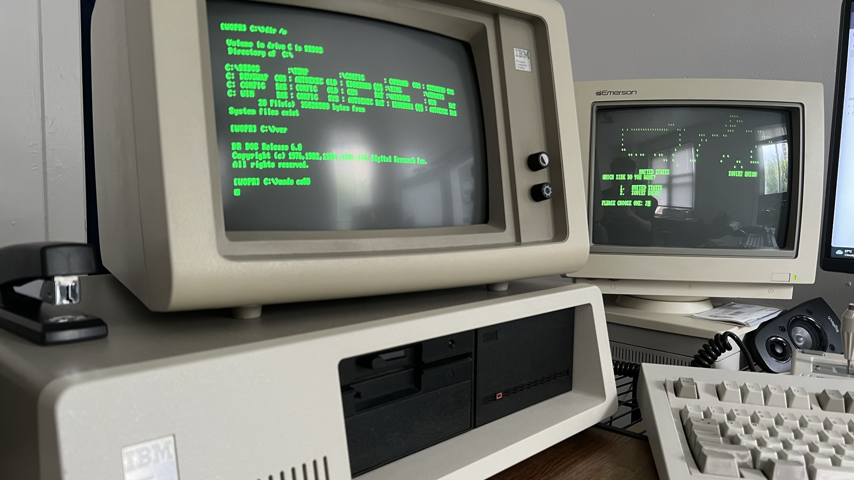
Where to put the WOPR?
The IBM 5150/60, or the IBM PC(/XT), are the first computers to come with 5.25-inch full height drive bays. They originally contains 2 Tandon 360k DD floppy drives, and later models like my PC/XT contains 1 or 2 360k half-heigh floppy drives and 1 Western Digital WD-25 20 Million Characters Fixed disk drive.
The IBM fixed disk controller recently gave up and started to throw ECC errors. Unable to source the SRAMs used as its disk buffers, it’s time to replace the drive! WOPR would fit right in, right?

Slide 4
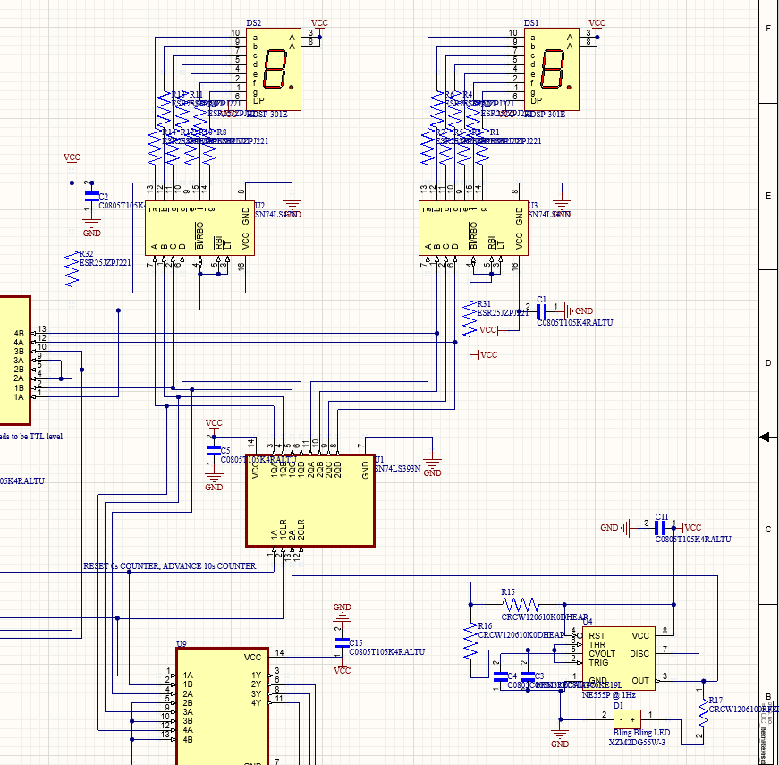
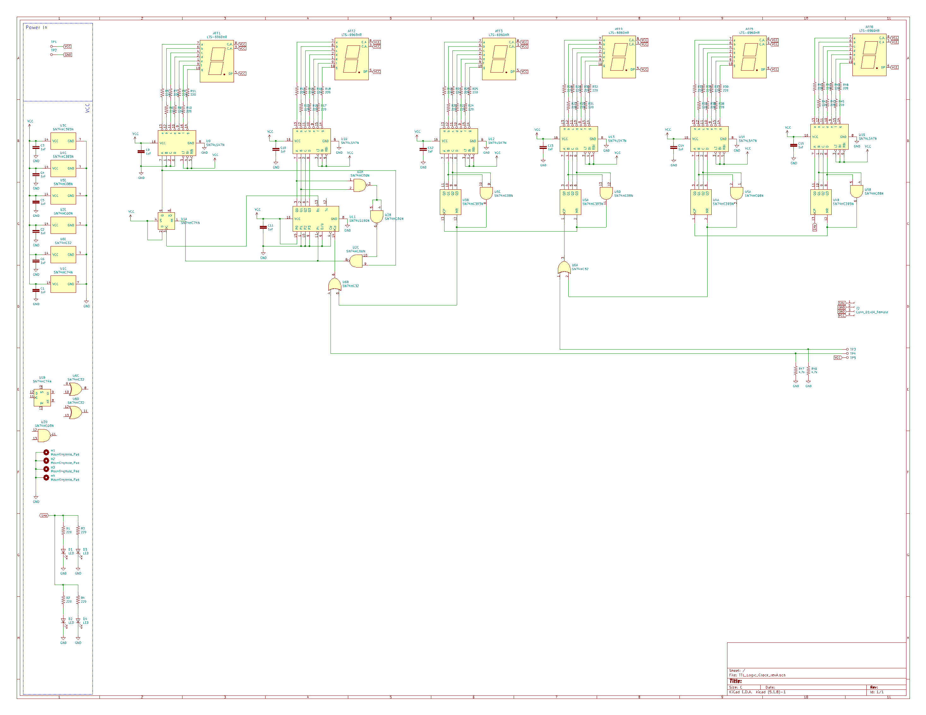
Original Design
The design took inspiration from my previous ignition board design for the Pitt SOAR rocket team, whose count-down clock section was in turn based on a 7400-series digital clock on hackster.io - 7400 Series Logic Clock - Hackster.io. The 7400-clock on hackster.io used a Maxim Integrated DS3231M I2C real time clock to provide the 1Hz square wave, but I substituted it with a 555-timer running at 1Hz for SOAR.

Slide 5
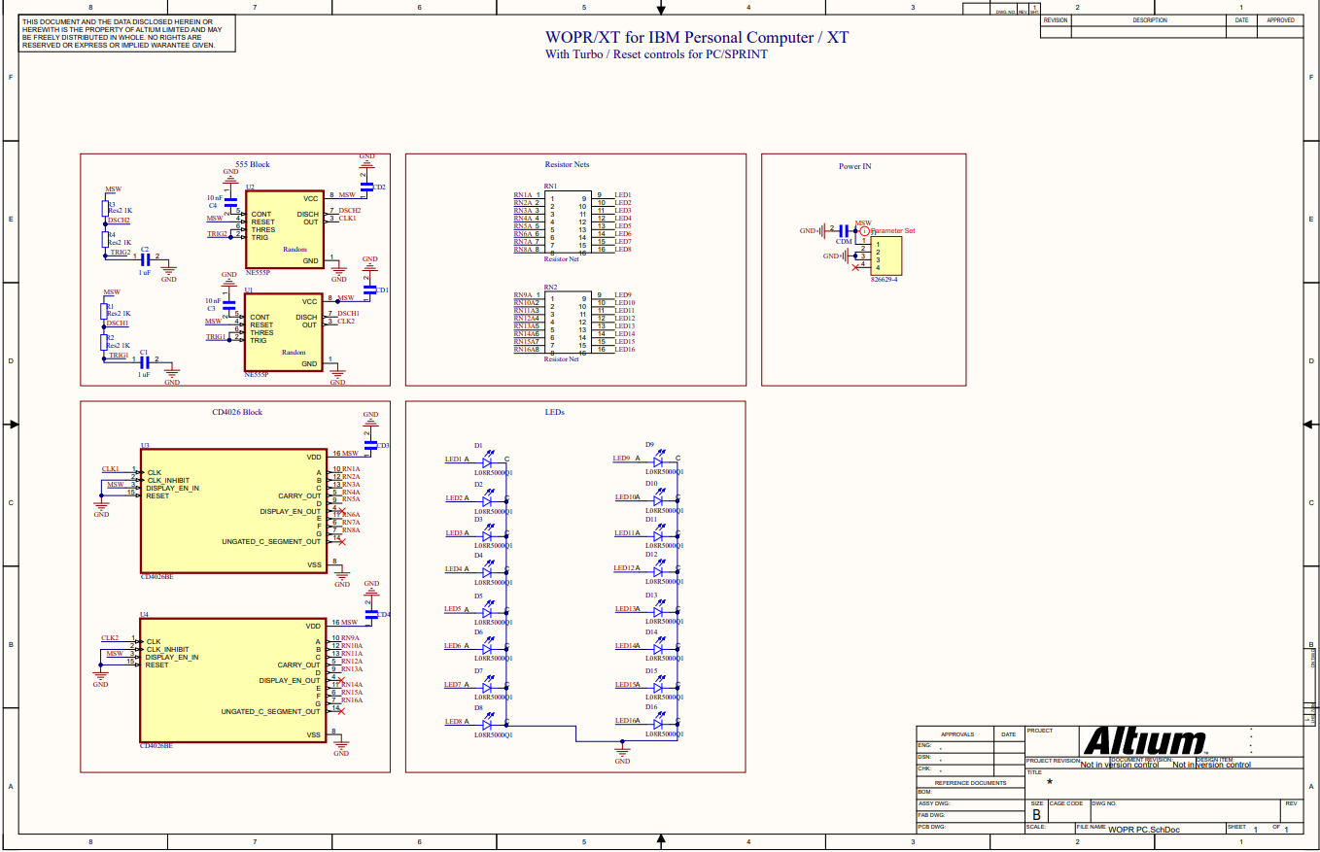
Modification + Improvements
The new design done away with the 7400 series logic and combined the entire counting + 7Seg driver circuitry with the CD4026 decade counter + display driver chip. The CD4026 will then directly drive 16 LEDs instead of 2 7-seg displays to create the illusion of “randomly blinking LEDs thinking how to win a good game of chess.”
The entire board will be powered by the IBM PC’s 12V power supply with a MOLEX 4 pos D-Connector –> 4 pin female header cable, which should be sufficient for the CD4026 CMOS chip to output the 20mA current needed for the LEDs.

Slide 6
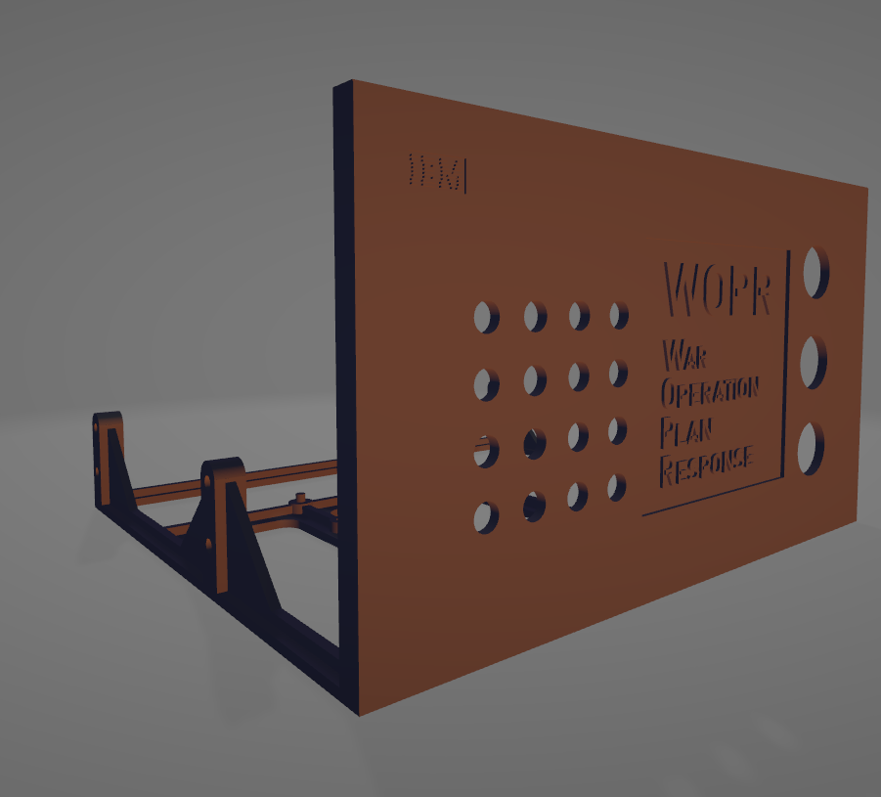
Enclosure Design
3D-printed 5.25-inch bay mount. The three holes on the right side of the front panel are for the RESET button, “TURBO” switch (both features of the home brew PC/SPRINT clock board, boosting the 8088 from 4.77MHz to 7.2MHz) and the WOPR’s master power button in case it tries to launch nukes.

Slide 7
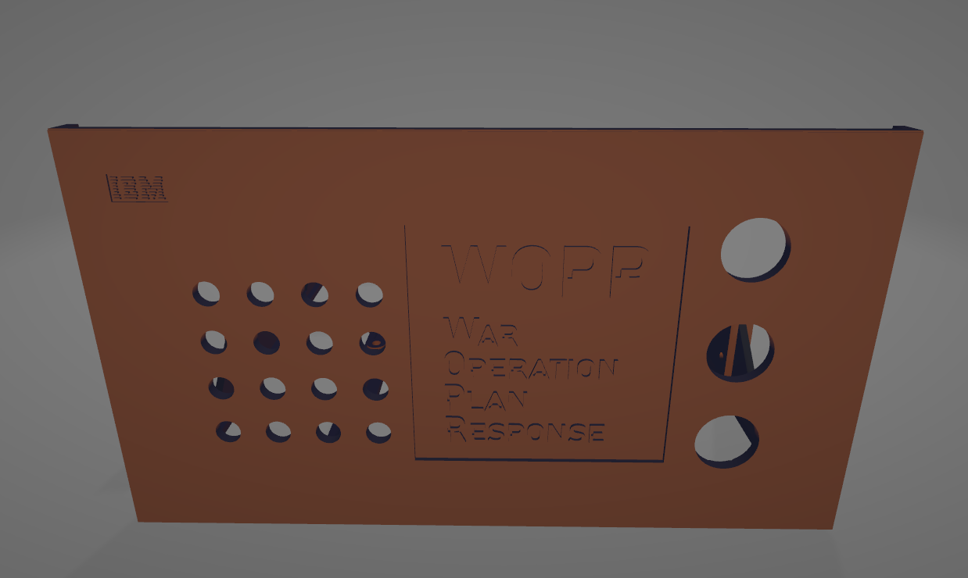

Slide 8
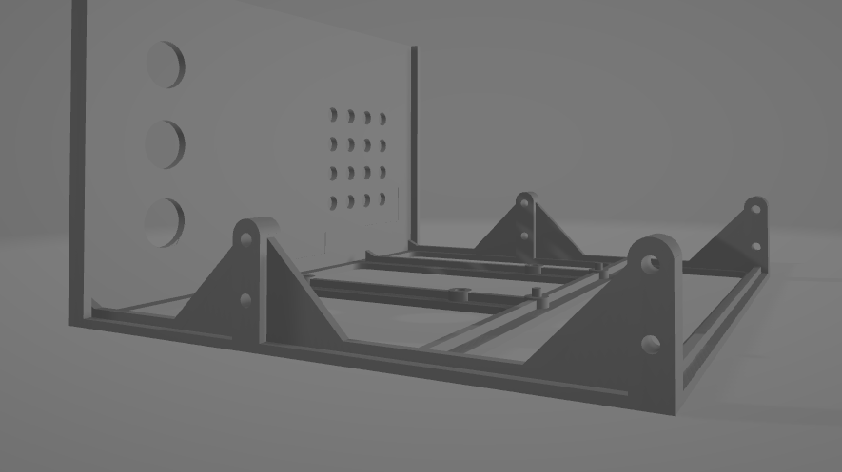

Slide 9
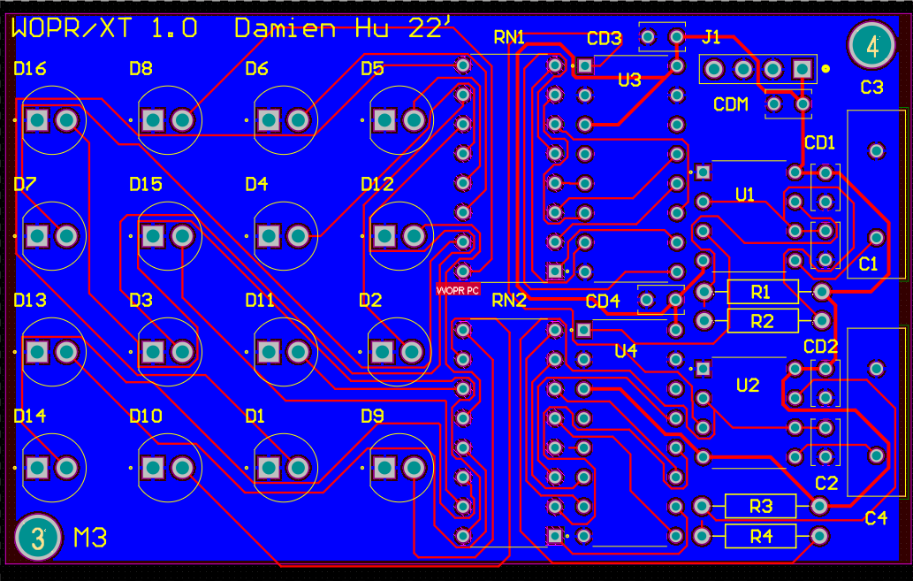

Slide 10
